Slide 1
Getting Started with Windows 10
Presented by: Manal Asghar

Slide 2
Introduction to Windows 10:
Windows 10 is an operating system developed by Microsoft that manages computer hardware and software. It allows users to run applications, manage files, and connect to the internet
Main Editions:
Windows 10 Home – For personal use
Windows 10 Pro – For business and professional use
Windows 10 Education – For students and institutions
Windows 10 Enterprise – For large organizations
Windows 10 is widely used because of its stability, security, and user-friendly interface.

Slide 3
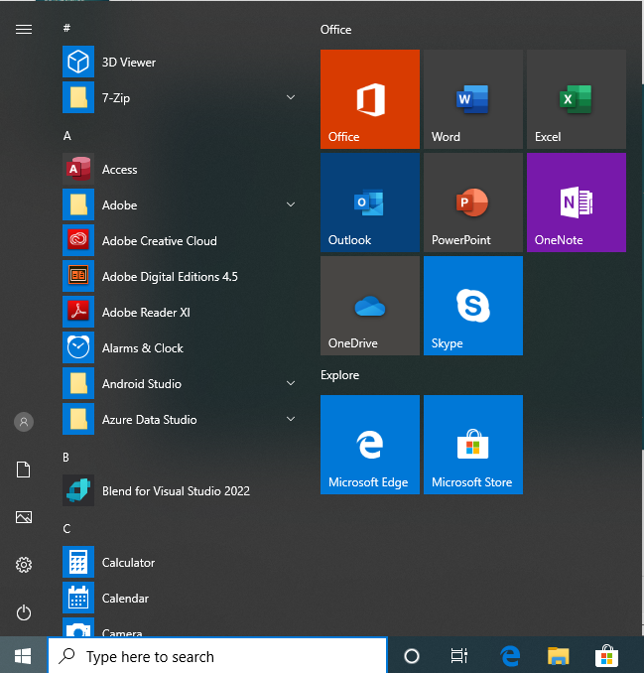
Key Features of Windows 10
Start Menu
the Start Menu is the main access point
in Windows 10.
It allows users to open applications,
access settings, and shut down or
restart the computer. It also displays
pinned apps and live tiles for quick
access.

Slide 4
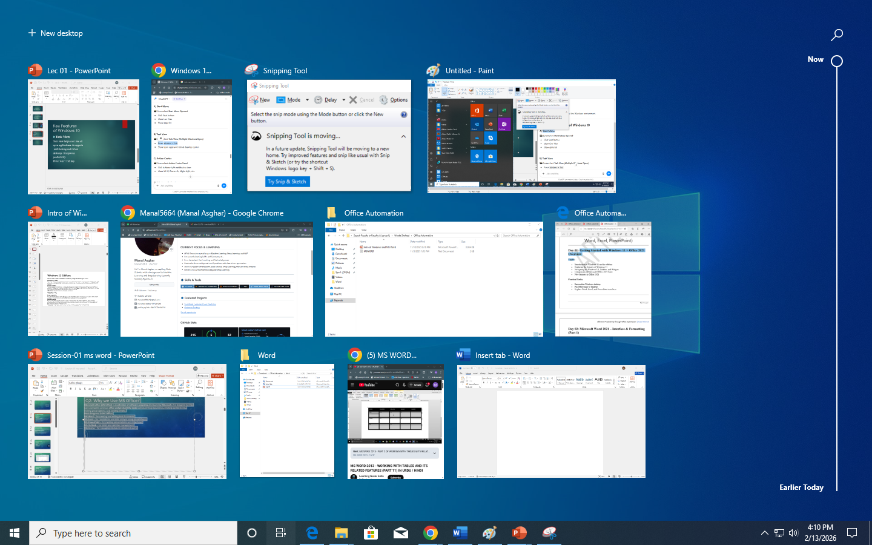
Key Features of Windows 10
Task View
Task view helps users see all
open applications. It supports
multitasking and virtual
desktops. It improves
productivity.
Press: win + Tab key

Slide 5
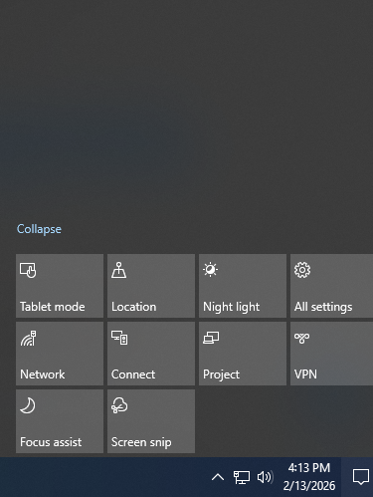
Key Features of Windows 10
Action Center
Action Center shows notifications and quick settings.
It allows access to Wi-Fi, Bluetooth, and other controls. It helps manage system alerts.
Click bottom-right notification icon

Slide 6
Key Features of Windows 10
Task bar
The Taskbar is located at the
bottom of the screen.
It provides quick access to
open and pinned applications.
Taskbar

Slide 7
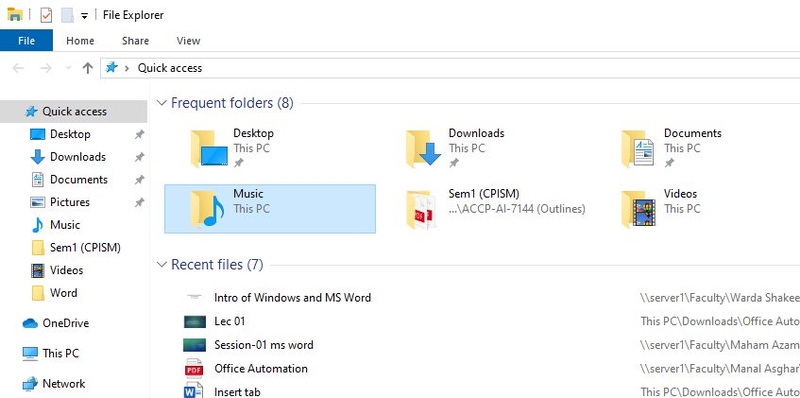
Key Features of Windows 10
File Explorer:
File Explorer is used to manage files and folders.
It allows users to copy, move, and delete files.
It provides access to drives and documents.
Press Ctrl + E

